Slide 1
AB Testing on my Github Page using VWO.com
Marcus Vos

Slide 2
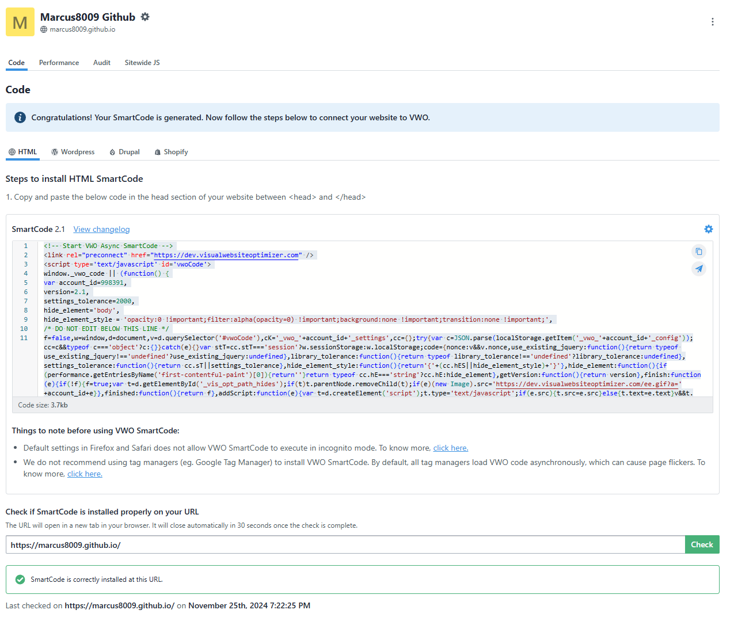
Code is added to my GitHub index.html page to allow the website to conduct AB testing.

Slide 3
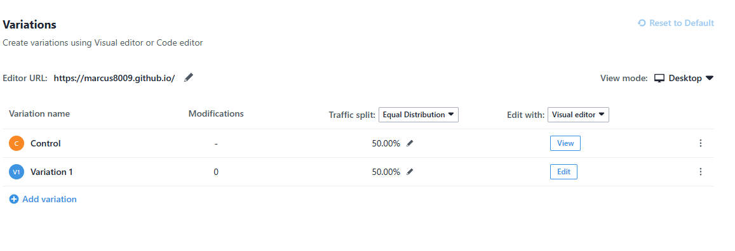
Only Control and One Variation is tested.
Users to the website will randomly be split between the two groups.

Slide 4
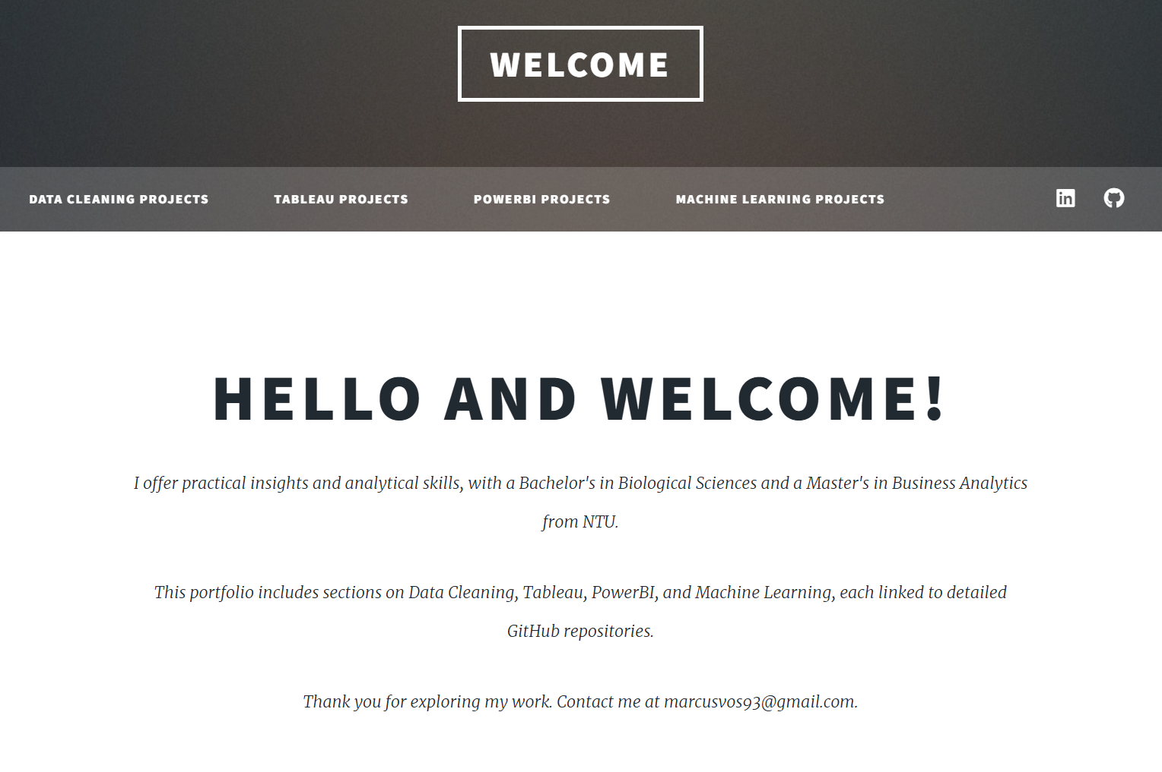
Control Page or A is shown here.
It is less wordy as compared to B or Variation1.

Slide 5
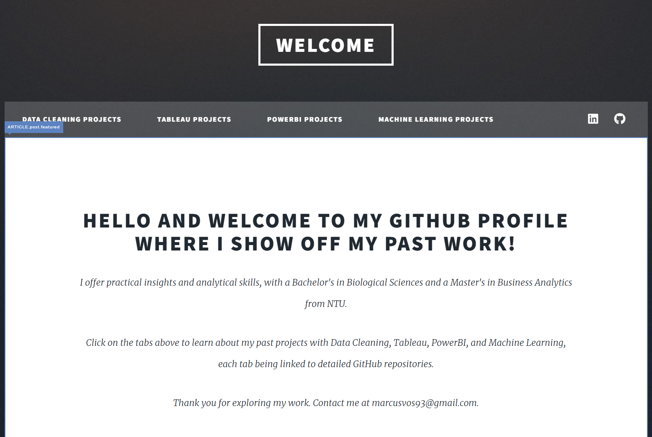
Variation 1 or B is shown here.
It is wordier and encourages the viewer to click tabs.

Slide 6
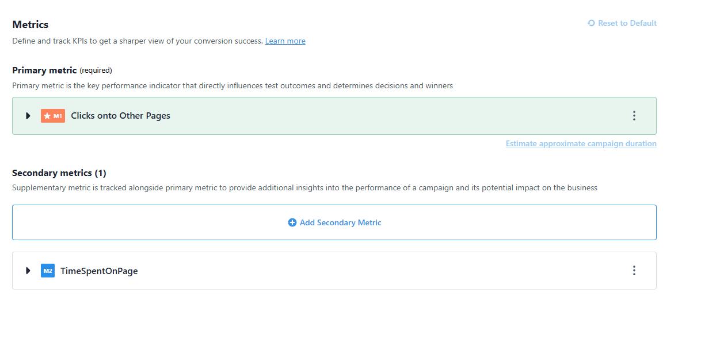
Two Metrics Are tested for this AB test.
First Metric is whether user clicks onto another page.
Second Metric is how long user spends on the page.

Slide 7
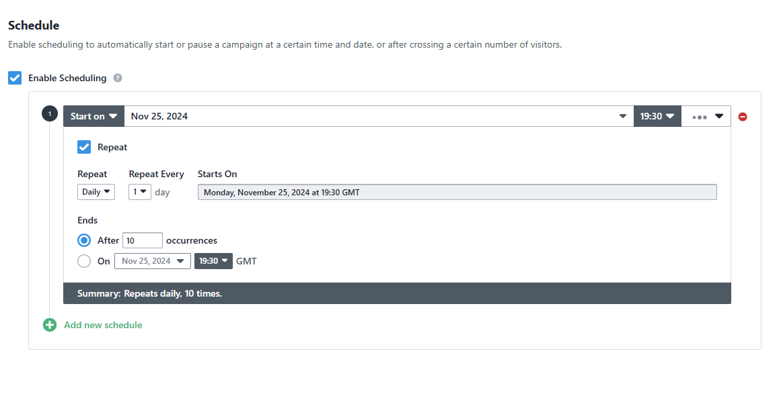
Experiment duration is defined here.

Slide 8
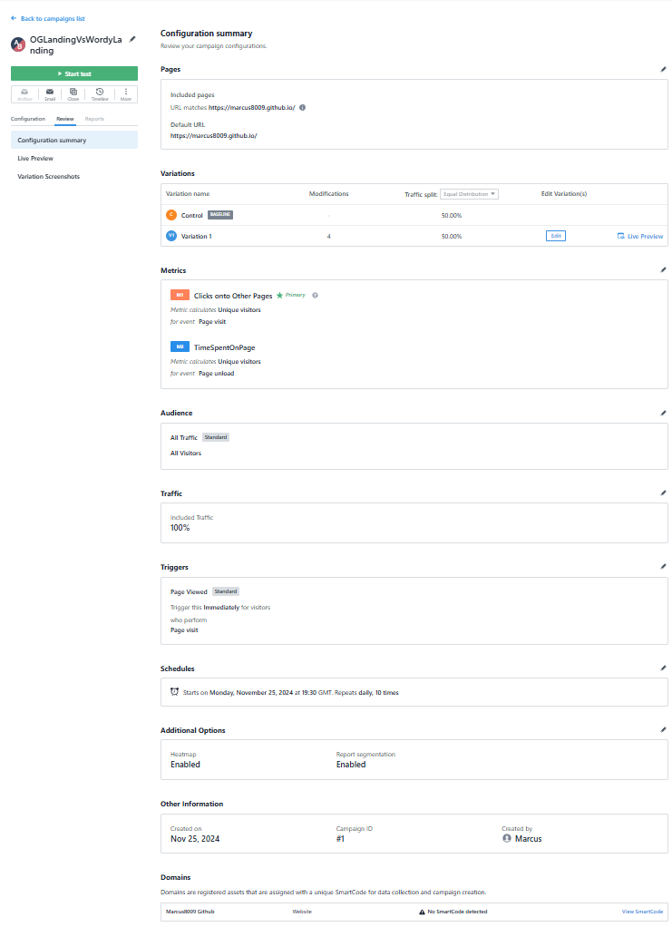
Final Experiment Settings are shown here.

Slide 9
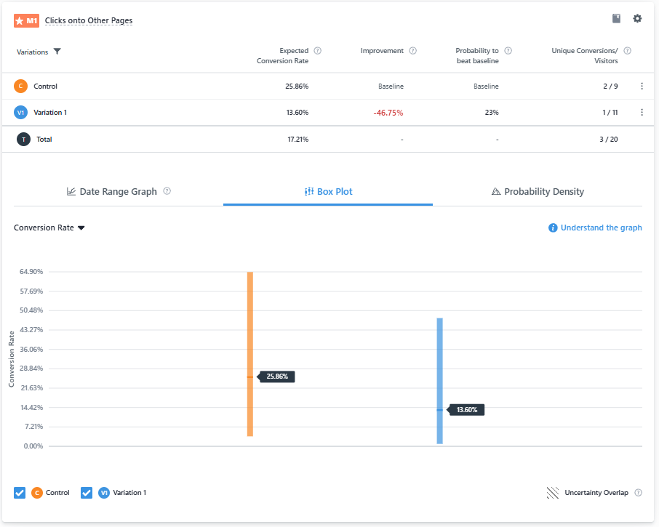
Results of Click onto other pages Metric
Conversion rate for clicks is 25.86% for Control and 13.60% for Variation 1.

Slide 10
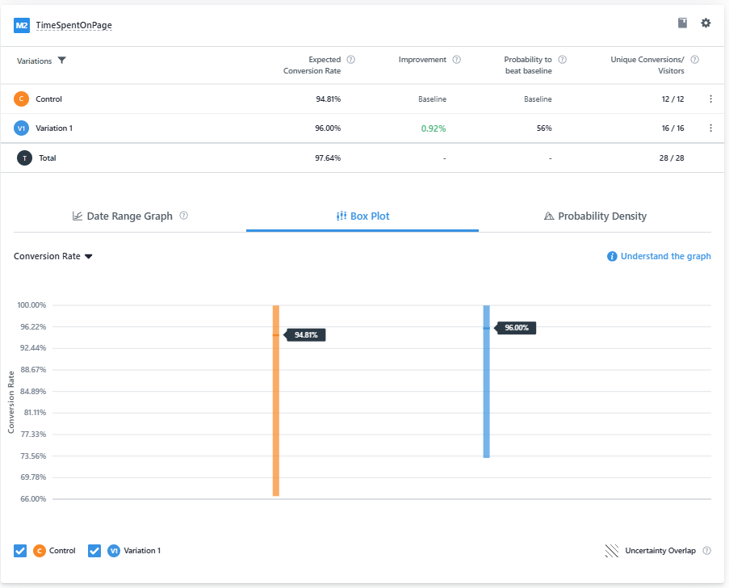
Results of Time spent on page Metric
There is 0.92% improvement in time spent on page for Variation 1 as compared to control.

Slide 11
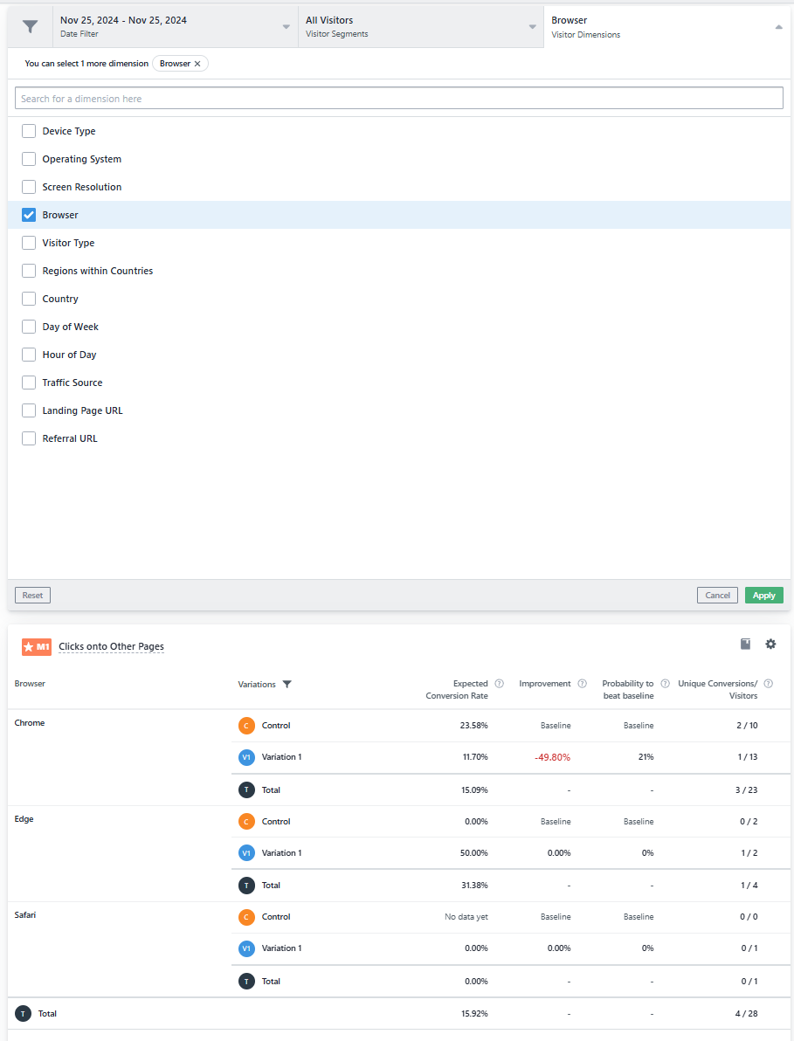
Other Info Available for Collection

Slide 12
Conclusion
The conclusion of the experiment is that the less wordy control website page is better at getting the interest of the user as click rate is significantly higher.
The wordier Variation1 has longer time spent on page, but much lower click rate thus it is not worth using.

